Slide 1

CSC 490 – Senior Capstone Project Presentation
4/25/17

Slide 2
Introductions
Anthony Ratliff
Trayvon McKnight
J’lesa Carr

Slide 3
Agenda
Member Roles
Problem Discussion
Solution
Models/ Subsystems
Database
Server
Graphical User Interface
Demos
Registration
Log-in & Navigation
Teacher vs Student Login
Chatrooms
Challenges
Future Plans
Q&A

Slide 4
Member Roles
Anthony R.
Trayvon M.
J’lesa C.
Client- Server Communication
Database Management
User Interface
Documentation
Database Management
Design

Slide 5
When it comes to classes and absences, some people would rather be without the day’s information than to find someone willing to share their notes.
Problem
- Anthony Ratliff

Slide 6

Solution
StuddyBuddy aims to allow students who share classes to communicate with their classmates and send/receive notes from the day.

Slide 7
Project Name: Study Buddy
Solution (continued)
Project Description:
Eliminate face to face interaction
Find those who are willing to share notes
Join a specific class chatroom
Ability to speak publicly
Ability to speak privately
Ability to view images containing notes
Notes:
The user will have the option to join a specific class chatroom and see all of the other students in the class. They will have the ability to speak to everyone publicly or be able to send private messages. The instructor for each class will take attendance for the day and that will populate a list of the opposite status based off the user attendance that day.

Slide 8
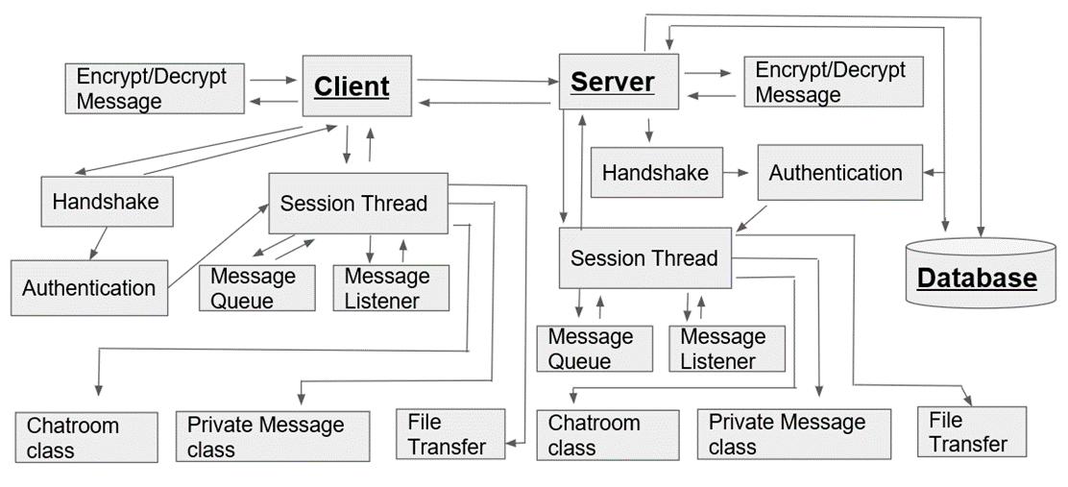
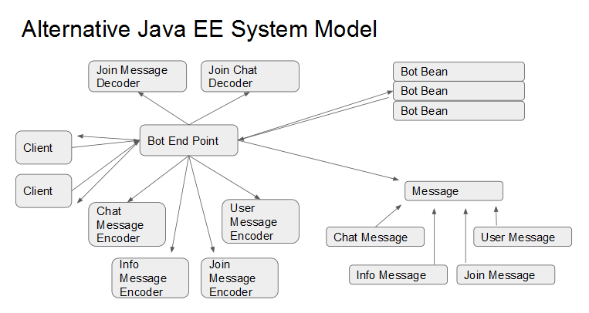
Models

Slide 9
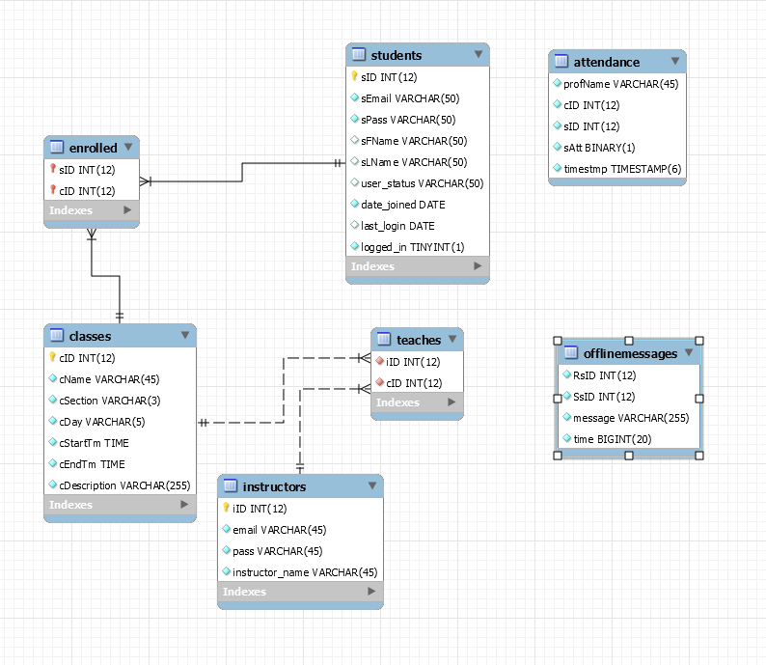
Database
Values in Tables -
Students & Teacher: identifying information
Enrolled & Teaches : Foreign Keys linked to class and person
Attendance: Standalone used on teacher end
OfflineMessages : Holds ID #s of sender/recipient and messages until online again
Queries
Students/Teacher : Server/ Display Profile
Login
Change Password
Enrolled/Teaches: Class Display
Classmates
Chatrooms
Attendance : Daily Update
Chatroom Logo Update
OfflineMessage: Message Retrieval on Login

Slide 10
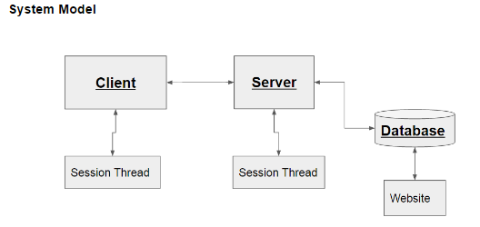
Subsystems
Database
Server
User Interface

Slide 11
Client / Server Communication Requirements
Chat hub to handle multiple communications.
Let user know when the server is unavailable.
Allow a user to create a new account.
User authentication for logging into the chat hub.
Assigning students to the correct class.
Saving chat room messages for offline users.
Ability to see who is logged into the chat hub.
Notifications of student and server messages.
Ability to send and receive files.
Secure all data across the internet.

Slide 12
Client / Server Model
Alternative Model

Slide 13
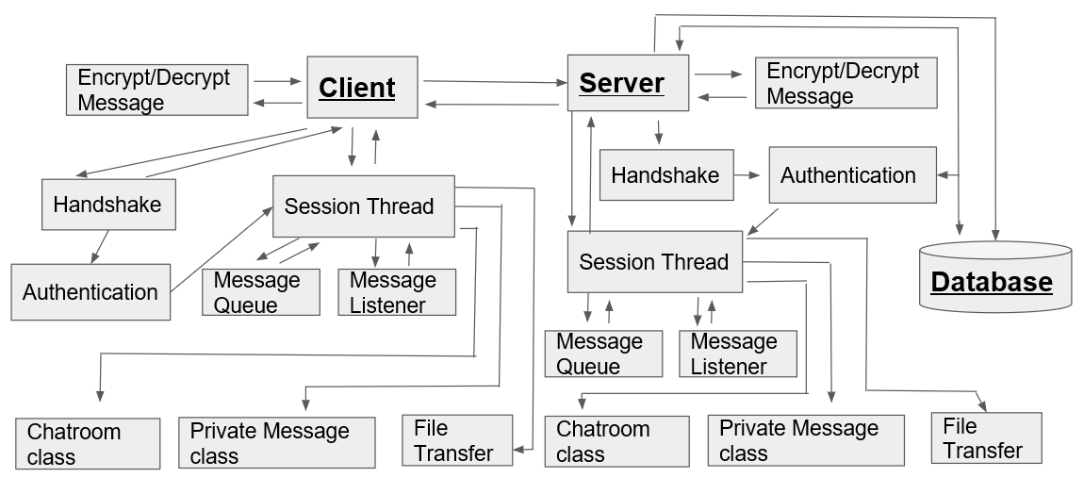
Client / Server Model
Selected Model:

Slide 14
Client / Server Handshake Protocol
CLIENT
SERVER
Diffie-Hellman Elliptic Curve
AES 128 - CBC
HMAC - SHA 256
Key Exchange Symmetric Cipher
HANDSHAKE
HANDSHAKE
05:HANDSHAKE:STUDYBUDDY:1.20:::01

Slide 15
Client / Server Login
Login Responses:
No User
Incorrect Password
Handshake First
Login Accepted
New Account Responses:
Email Exists
Bad Password Format
New Account Accepted
CLIENT
SERVER
AUTHENTICATION
AUTHENTICATION
Login
New Account
Login
New Account
01:LOGIN:<email>:<password>:::01
09:CREATEACCOUNT:<email>:<pass>:<fname>:<lname>:01

Slide 16
Client / Server Sessions
Message Queue:
Linked Blocking Queue
Processes Commands
Separate Thread
Message Listener:
Decrypts Messages
Puts messages on queue.
Separate Thread
CLIENT
SERVER
SESSION
SESSION
Message Queue
Message Listener
Message Queue
Message Listener
04:CHANGEPASS:<oldpass>:<newpass>:::01
04:CHANGEPASS:<oldpass>:<newpass>:00:SUCCESS:00

Slide 17
Client / Server Cross Session Communications
Client
Session
Session
Client
Client
Session
Session
Client

Slide 18
Client / Server Chat Room Data Structure
Chat Rooms
Chat Room
Chat Room
Chat Room
Students
Students
Students
Messages
Files
Messages
Files
Messages
Files

Slide 19
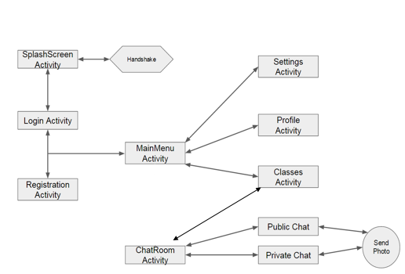
User Interface

Slide 20
Demonstration

Slide 21
Challenges
DB :
Manual Input
Repopulating
Foreign Keys
Server
Sending Pictures
UI
Custom Adapters

Slide 22
Future Efforts
More Intuitive UI
Incentivize sharing notes.
Create scripts to automatically load data
Add more security features.
Add Shutdown feature

